Slide 1
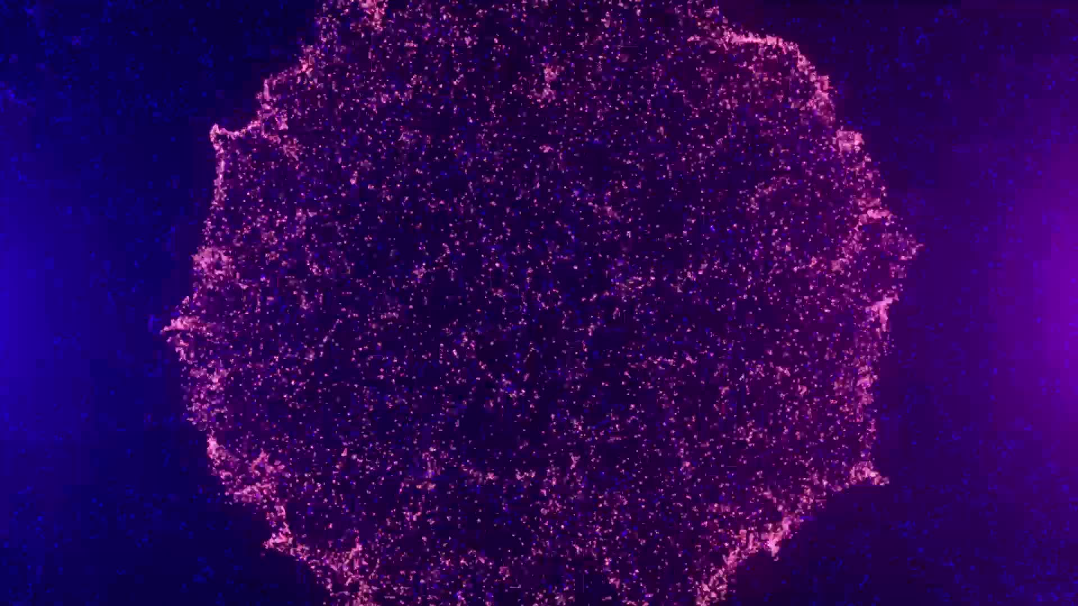
IMAGE MALWARE Classification
-Pranaydeep Mayank
19BAI1026
-Shekhar Iyer
19BAI1055

Slide 2

DATASET USED: Malimg dataset
The Malimg dataset consists of 9339 images of 25 classes, and hence these samples require no pre-processing before applying image-based analysis. However, the binaries corresponding to the Malimg images are not readily available.

Slide 3

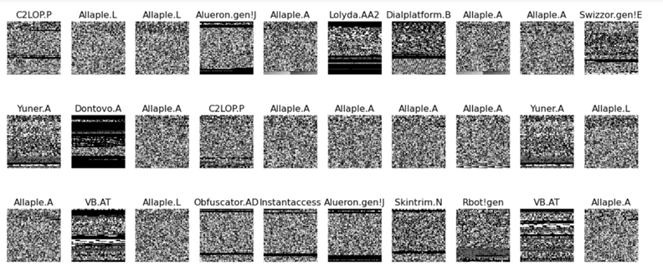
Sample Dataset

Slide 4
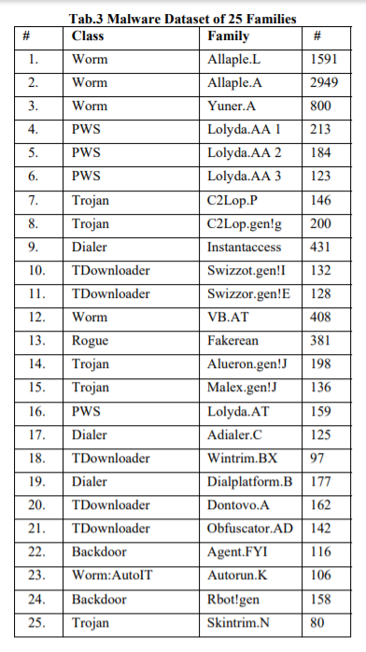
Malware Classes

Slide 5
Using deep learning for malware detection
Byte code -> grayscale image
Apply deep learning model
classify

Slide 6
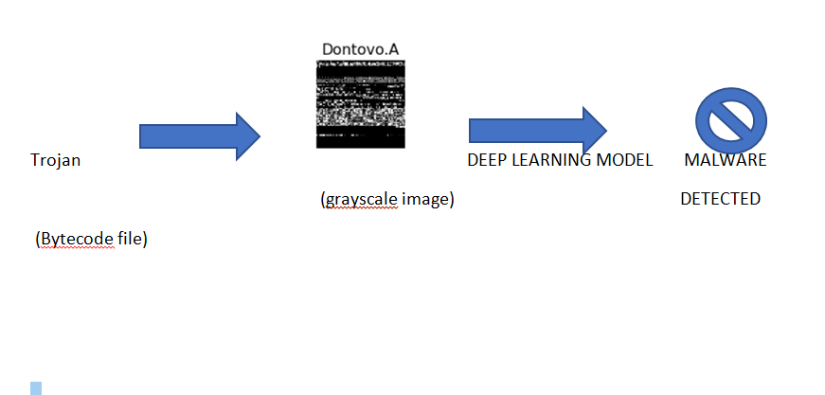
Using deep learning for malware detection

Slide 7
Methods:
Malware image Classification using CNN
Malware image classification using Transfer learning technique

Slide 8
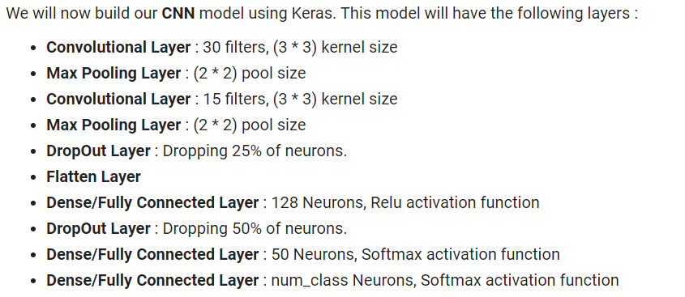
Using convolutional neural networks for malware detection

Slide 9
Transfer learning
Resnet50
Resnet101
Vgg-19
Inception V3

Slide 10
Thank you

